Slide 1
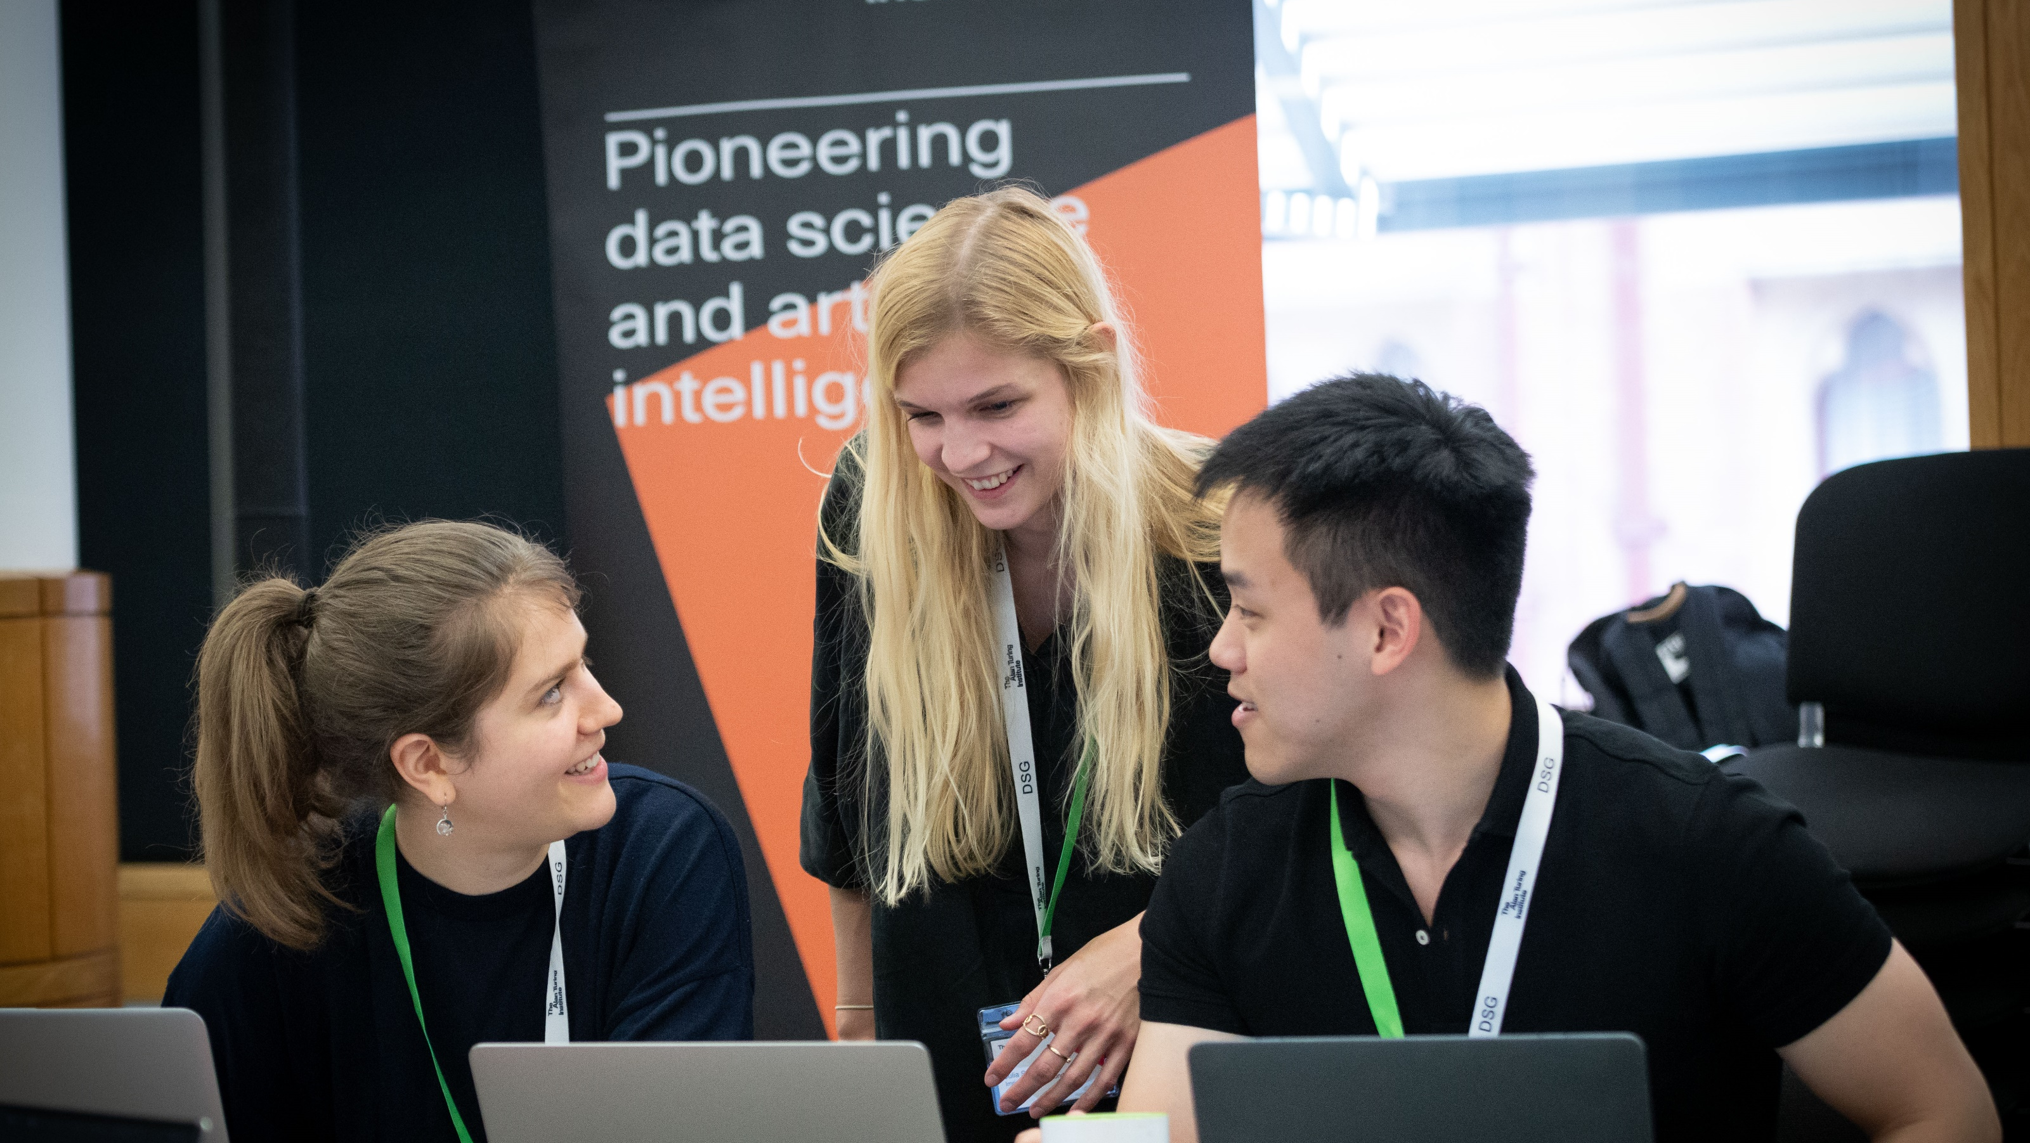
Facilitator Training
The Alan Turing Institute Data Study Group

Slide 2
Welcome & Thank you!
Data Study Groups would be impossible without facilitators so a huge thank you

Slide 3
Introduction to The Data Study Group from Jules Manser, Data Study Group Project Manager

Slide 4


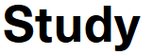
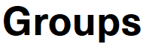
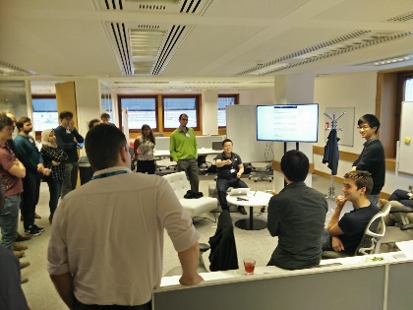
What are
?
5-day ”collaborative hackathons”, studying data-driven challenges
e.g., “can we predict therapy success?”, “generate insight from imaging”
convening broad range of data scientists to work on application problem
Day 1: Challenge is presented by the data/challenge owner
Days 2-4: Brainstorming, modelling and problem solving
Day 5: presentation, progress and recommended routes forward
Key outputs:
written report on findings, forward avenues; (dirty) code
Key outcomes:
proof-of-concept; collaborative working group; follow-on activities
Notes:
RECURRING THEMES:
convening power of Institute,
bringing different Institute programmes/teams together,
future SPF DSGs
Intense but fun
Socialise
Food and activities

Slide 5
What is a facilitator?
The facilitator of collaboration that brings out the best in everyone by;
-Overseeing interactions within the team
-Ensuring interpersonal communications are clear
-Making sure that all work conducted is documented and included in the report
-Ensuring the project is managed transparently

Slide 6
What a facilitator is not
-Responsible for the science (in its entirety)
-The boss/manager
-Responsible for answering admin questions
-Responsible for the quality of the final report

Slide 7
Meta-facilitators
Consider them the facilitator for the facilitators. We are focused on enabling your success (which will cascade down to the success of your team).
The ‘meta-facilitators’ will be available by email, on slack and phone in advance of the data study group and throughout the week itself.

Slide 8
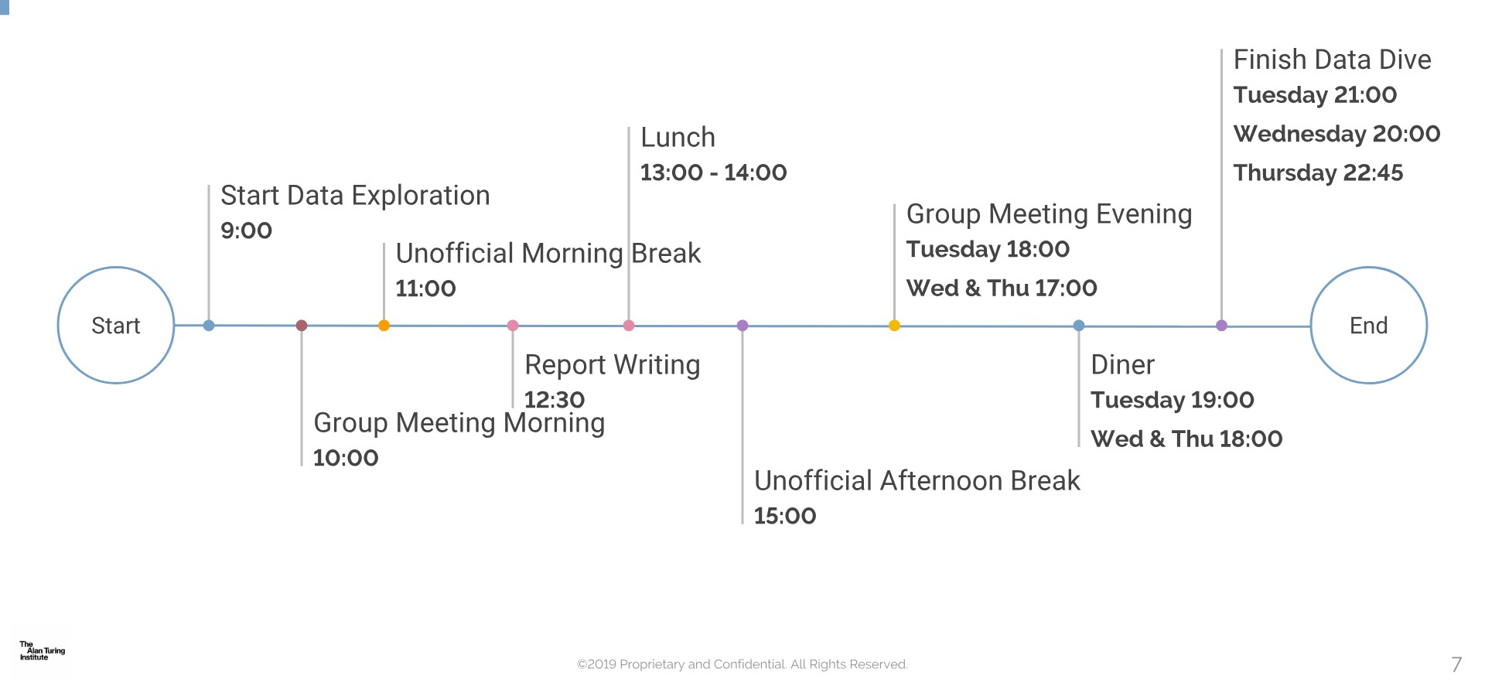
Data Study Group Daily Schedule

Slide 9
Facilitator/ Meta- facilitator Meetings
The morning ‘check in’, this is your chance to flag any serious issues, this meeting will take no longer than 15 minutes.
The post lunch ‘catch up’. This is your chance to ask for advise, raise any topics for discussion and report any issues. (You don’t have to attend the afternoon catch up if everything is going great within your team!)

Slide 10
What does it mean to facilitate?
Over to Ben Murton, Head of Researcher Development and Training

Slide 11
Lunch

Slide 12
Using the printed instructions please try and access your data

Slide 13
How to Access the Data
Instructions will be printed in the individual challenge rooms:
Multi factor authentication required
Open up the link in a browser (not on your phone)

Slide 14
Folder Structure
As facilitator one of your first jobs will be to create a folder structure in overleaf which will encourage correct storage/documentation of work REMEMER EVERYTHING MUST BE DOCUMENTED
‘Outputs’ > ‘report’ ‘code’ ‘images’ ‘data’ ‘presentation’

Slide 15
Saving Outputs
There will be a close down check list on Friday to make sure that everything is saved properly.
Alvaro or James will show you a bit later on how to save outputs and images in HackMD ect. Including having correct links in HackMD/GitLab.

Slide 16
Technical Overview, with Dr James Robinson, Senior Research Software Engineer

Slide 17
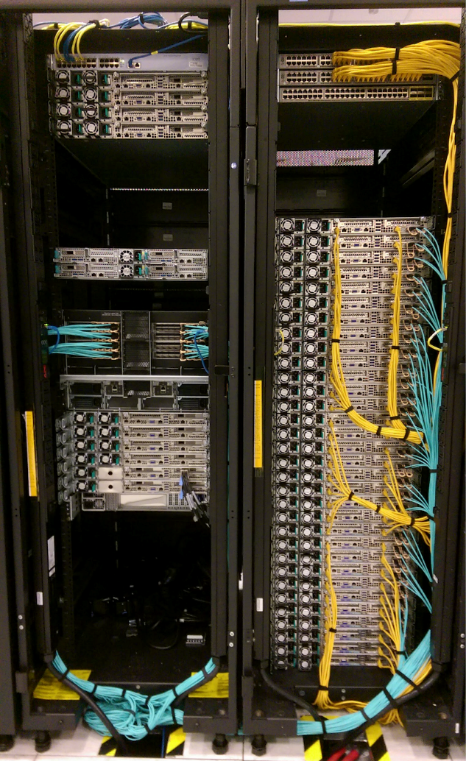
The Safe Haven Project
What makes a Safe Haven a Safe Haven is the approvals it gets from the various Data Controllers it serves to hold their personal data. It is not just the technology that secures the data, but also the processes and contractual agreements that enforce it.
Data classification:
Apart from tier 0, all other tiers will be hosted in the data safe haven. The higher the tier, the more restrictions are placed on what the user can do within the analytical environment. The more restrictions in place, the harder it is for analysis, which will impact the output.
Public | Tier 0
Publishable | Tier 1
Official | Tier 2
Sensitive | Tier 3
SECRET | Tier 4
https://www.turing.ac.uk/research/research-projects/data-safe-havens-cloud
Notes:
We do not host tier 4 data at this time
We are currently building a safe haven environment that will sit within the Microsoft Azure Cloud platform
Balance security needs and ability of the researchers to be able to do the work they need to do
Secure slow – cant be done for a week work

Slide 18
How to Run Analyses in a Secure Environment

Slide 19
Tools Available
Azure data science virtual machine: https://docs.microsoft.com/en-us/azure/machine-learning/data-science-virtual-machine/overview
Installed python packages
Installed R packages
GitLab

Slide 20
How to communicate tech problems to the team
Monday can sometimes be a bit crazy!
Log it on GitHub
Or Slack
And bear with us ☺

Slide 21
Q&A?

